Slide 1
Load Balancer
Load balancing means distribution of load across the distributed systems.
Eg: Computers, clusters, networks, etc.
Dedicated Hardware and Software.
Optimize resources use
Maximize throughput
WHY?
Minimize response time
Avoid overload

Slide 2
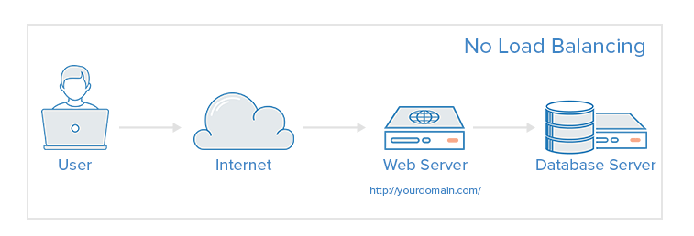
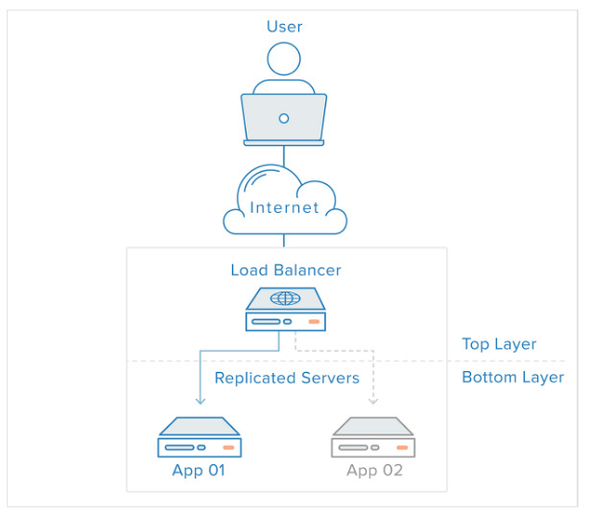
Web infrastructure with no load
balancing
With load balancing

Slide 3
Types of load balancers
Software load balancers – implements a combination of scheduling algorithms
Weighted scheduling algorithms
Traffic sent to a server according to weight assigned to it. Weight determined according to hardware capabilities
Round robin scheduling
Requests are served by servers sequentially
Least connection first scheduling
Request served first to server currently handling least number of persistent connections

Slide 4
Types of load balancers
Hardware load balancers – device between client and server to balance the load
Layer 4 Hardware load balancing
These kind of load balancers work on transport layer of OSI model and make use of TCP, UDP and SCTP transport layer protocol details to make decision on which server the data is to be sent.
Layer 7 Hardware load balancing
makes the decision according to the actual content of the message (URLs, cookies, scripts)
For example, the request for image will go to an image server, request for PHP scripts may go to another server

Slide 5
Examples of load balancers
Hardware based
F5 BIG-IP Local Traffic Manager – intelligent traffic management, based on full proxy architecture
Cisco Load balancer – router products have load balancing capabilities inbuilt. Features include sticky sessions, TCP session reassignment, automatic unfail
Barracuda Load balancer – provides intrusion prevention, global load balancing and content caching
Coyote point – supports all web based applications. Also supports round robin and weighted load balancing algorithms

Slide 6
Examples of load balancers
Software based
Resonate central dispatch - software-based advanced load balancing solution that utilizes patented resource-based scheduling technology to orchestrate routing decisions based on actual statistics and heuristics obtained from the server and network data centre infrastructure.
Zen load balancer – software based, open source
NGINX Plus – software based, features like automatic health check, session persistence, live activity monitoring

Slide 7
References
https://www.serverwatch.com/server-tutorials/slideshows/11-load-balancers-you-need-to-know-in-2016.html
http://www.thegeekstuff.com/2016/01/load-balancer-intro/
https://www.digitalocean.com/community/tutorials/what-is-load-balancing

